Slide 1
SWE General Meeting: Elections
03/04/13

Slide 2
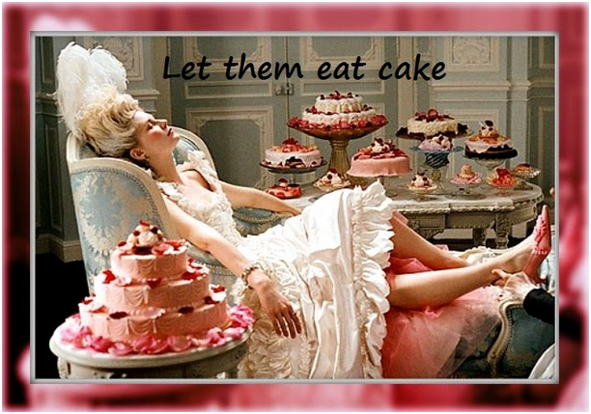

Slide 3
Icebreaker: Marketing yourself
Nominees will socialize with the members and market themselves.
Let the members know why you are the BEST candidate for this position.

Slide 4
Questions to Ask the Candidates:
Why should I vote for you?
What leadership experience do you have?
What are you main interests in SWE
What are your strengths?
What are your visions for the club next year?
What other clubs are you involved with?
How do you manage your time?
What would your patronus be?

Slide 5
Upcoming Events
Event | Date | Location | Time
Getaway Fundraiser | 03/07/13 | Getaway | 7-11PM
Highlander Day | 03/09/13 | BCOE | 9-11AM
Girl Scout Astronomy Night | 03/09/13 | Seal Beach | 5-8PM
Bourns Engineering Day | 04/06/13 | BCOE | 12-5PM

Slide 6

Getaway Fundraiser

Slide 7
Highlander Day
Tabling for incoming/interested students.
Pitch SWE, tell them why we’re awesome.

Slide 8
Astronomy Night
SWE-OC will be helping out with an Astronomy Night Event for the Seal Beach Girl Scouts.
We will be helping them with an activity to identify plantets, how to use a telescope and also answering questions about Women in Engineering.

Slide 9

Bourns Engineering Day

Slide 10
Webmaster
Idalia Ramirez
Connie To
Rachel Law

Slide 11
Historian
Vanessa Guzman
Cristal Gonzalez

Slide 12
Professional Development
Cristal Gonzalez
Brenda Pena
Danielle Coponpon

Slide 13
Social Chair (2)
Monica Marks
Brenda Pena
Christine Hawley
Danielle Coponpon

Slide 14
Outreach Coordinator (2)
Monica Marks
Odalys Garau
Suana Jaimes

Slide 15
Treasurer (2)
Sojin Ahn
Cristal Gonzalez
Leila Suasnabar

Slide 16
Secretary
Vanessa Guzman
Christine Hawley
Sandra Hernandez
Danielle Coponpon
Rachel Law

Slide 17
Vice President
Paige Romero
Tasnia Qazi
Beth Mende

Slide 18
President
Stephanie Eatinger
Tasnia Qazi

